Slide 1


BANK MANAGEMENT SYSTEM
BACHELOR OF TECHNOLOGY
COMPUTER SCIENCE AND ENGINEERING
Submitted
To
Dr. A.P.J. ABDUL KALAM TECHNICAL UNIVERSITY LUCKNOW
SUBMITTED BY:
Name: SHASHWAT
University Roll No. 2200100100300
UNDER THE SUPERVISION OF
MR. DHANANJAY SHARMA SIR
UNITED COLLEGE OF ENGINEERING AND RESEARCH, PRAYAGRAJ

Slide 2
UNITED COLLEGE OF ENGINEERING AND RESEARCH A mini project on Bank Management System Bachelor Of Technology By: SHASHWAT Under the Guidance of Mr. DHANANJAY SHARMA SIR

Slide 3
TABLE OF CONTENTS
SERIAL NUMBER | TITLE | PAGE NUMBER
1. | ABSTRACT | 1
2. | INTRODUCTION | 2
3. | OBJECTIVES | 3
4. | MODULES | 4
5. | BENEFITS | 5
6. | SYSTEM REQUIREMENTS | 6
7. | DATA FLOW DIAGRAM | 7
8. | ENTITY RELATIONSHIP DIAGRAM | 8
9. | DATABASE DESIGN | 9
10. | FUTURE SCOPE | 10
11. | BIBLIOGRAPHY | 11
12. | USER INTERFACE | 12,13,14,15,16,17,18
13. | THANK YOU | 19

Slide 4
ABSTRACT The Bank Management System is a web-based application designed to streamline banking operations, improve customer service, and enhance overall efficiency. The system will provide a user-friendly interface for customers, and administrators to manage accounts, transactions, and other banking services. The project involves various operations similar to that of a bank but with more effective and hassle free method. Once your documents are verified you are good to go with features of bank offering operations like create account, update account, deposit, withdraw, apply for loan , repay loan and all the records will be updated to the admin.

Slide 5
INTRODUCTION Banking: is the business of bank which provides financial services to individuals, businesses etc. Bank Management System effortlessly ensures efficiency in the operations of large scale Banks. The Bank Management System digitizes routine work of the bank such as efficiency, accessibility, security , scalability and customer satisfaction .

Slide 6
OBJECTIVE OF BANK MANAGEMENT SYSTEM - User Management (Customer, Administrator). - Account Management (Create, Update, Delete). - Transaction Management (Deposit, Withdrawal ). - Loan Management (Withdrawal ,Repayment). -To provide security at different level like bank id and username. -Safe Transaction.

Slide 7
MODULES There are several modules in the project, they are as follows: 1. Admin login :contain features update ,delete and show records. 2. Customer login : contain all basic operations of bank. 3. Create account: creates new account. 4. Deposit money : deposit money on basis of bank id. 5. Withdraw money : withdraw money on basis of bank id. 6. Update record : updates fields of pre-existing account 7. Delete record : deletes pre-existing account. 8. Check balance : displays record details. 9. Apply for loan : apply for loan on basis of bank id. 10. Repay loan : repay loan on basis of bank id.

Slide 8
BENEFITS 1. The Bank management System offers hassle less transaction methodologies. It dynamic , secure , robust , efficient and well organized architecture to manage your financial status. 2. Makes information retrieval fast and easier. 3. Less man power required. 4. Saves time and energy. 5. Protects the information from unauthorized access. 6. User friendly interfaces.

Slide 9
HARDWARE AND SOFTWARE REQUIREMENTS Following facilities are required in development of this project: - Spring Boot as the application framework - Java as the programming language - MySQL or as the database management system(Server Side). - HTML , BOOTSTRAP and CSS for the user interface(Client Side). - Postman to test the API. Java Development Kit (JDK 17) or above. Spring Tool Suit or Eclipse. Postman Application. Browser MySQL Database Minimum System Requirements: Ram: 4GB Processor: Pentium and above Storage : 7GB OS: Windows 7 and above

Slide 10
DATA FLOW DIAGRAM
Admin Login
New account
Login
Deposit
BANK MANAGEMENT SYSTEM
Operations Reflected On Database.
Bank Page
Withdraw
Check Balance
Info
Apply For Loan
Repay Loan

Slide 11
ENTITY RELATIONSHIP(ER DIAGRAM) v
Bank_ID
Loan_Amt
Name
BANK
Balance
Address
Phone_No

Slide 12
DATABASE DESIGN
FIELDS | TYPE | NULL | KEY | DEFAULT | EXTRA
Bank_ID | int(11) | No | PRI | NULL
Name | varchar(40) | Yes |  | NULL
Address | varchar(40) | Yes |  | NULL
Phone_No | varchar(40) | Yes |  | NULL
Balance | int(11) | Yes |  | NULL
Loan_Amt | int(11) | Yes |  | NULL

Slide 13
FUTURE SCOPE 1. More interactive with chatbots. 2. More secure with ORACLE database. 3. More features like joint account, savings account , salary account and recurrence account. 4. Transaction between accounts. 5. Web based document verification.

Slide 14
BIBLIOGRAPHY I would like to take this opportunity to express my gratitude to a number of people who have been sources of help & encouragement during the course of this project. I am very grateful and indebted to our project guide Mr. Dhananjay Sharma sir, our respected Dean Academic Mr. Vijay Kumar Dwivedi & our head of department Dr. Ashutosh Singh for providing their enduring patience, guidance & valuable suggestions. They are the one who never let the morale down & always supported me through our thick & thin. They are the constant source of inspiration for me & took utmost interest in my project. I would also like to thank all the staff members for their invaluable co-operation & permitting me to work in the computer lab. The arduous job of completing this project would never have been possible without the valuable help and assistance from : I would like to take this opportunity to express my gratitude to a number of people who have Computer Applications Book. 1. Geek For Geek site. 2. Javatpoint site. Senior Teachers: Dhananjay Sir Dinesh Sir Shashi Sir Vinay Sir

Slide 15
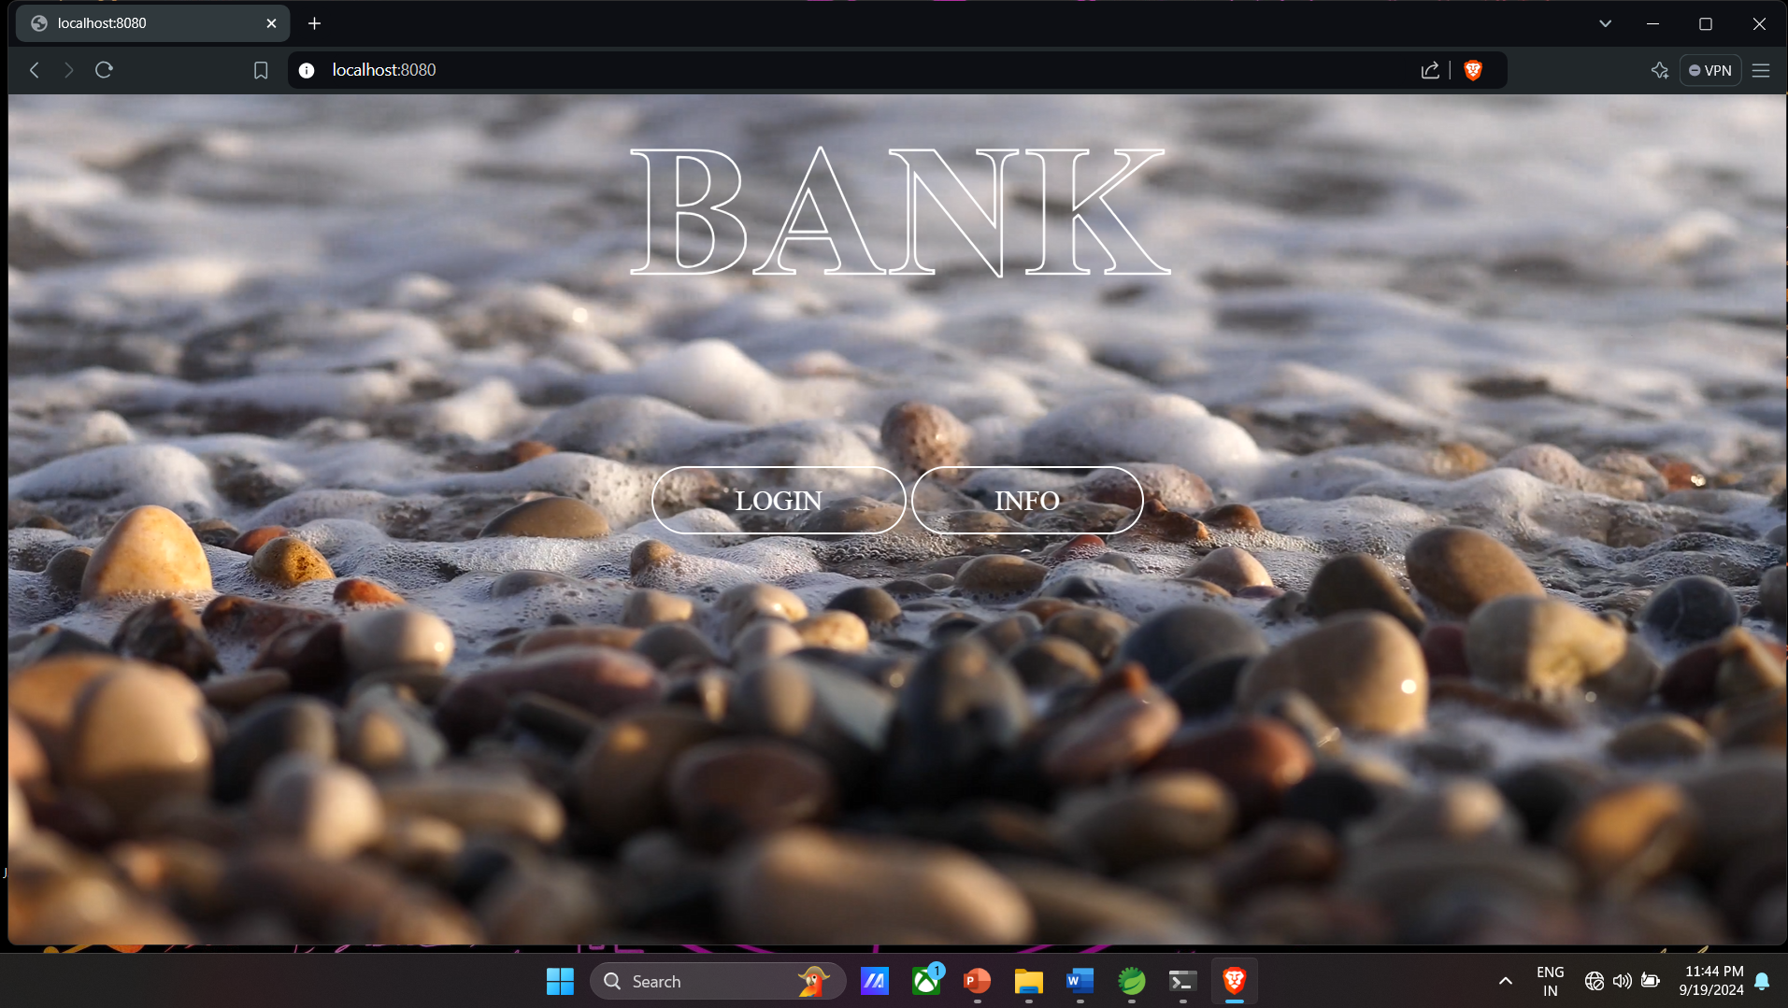

Slide 16
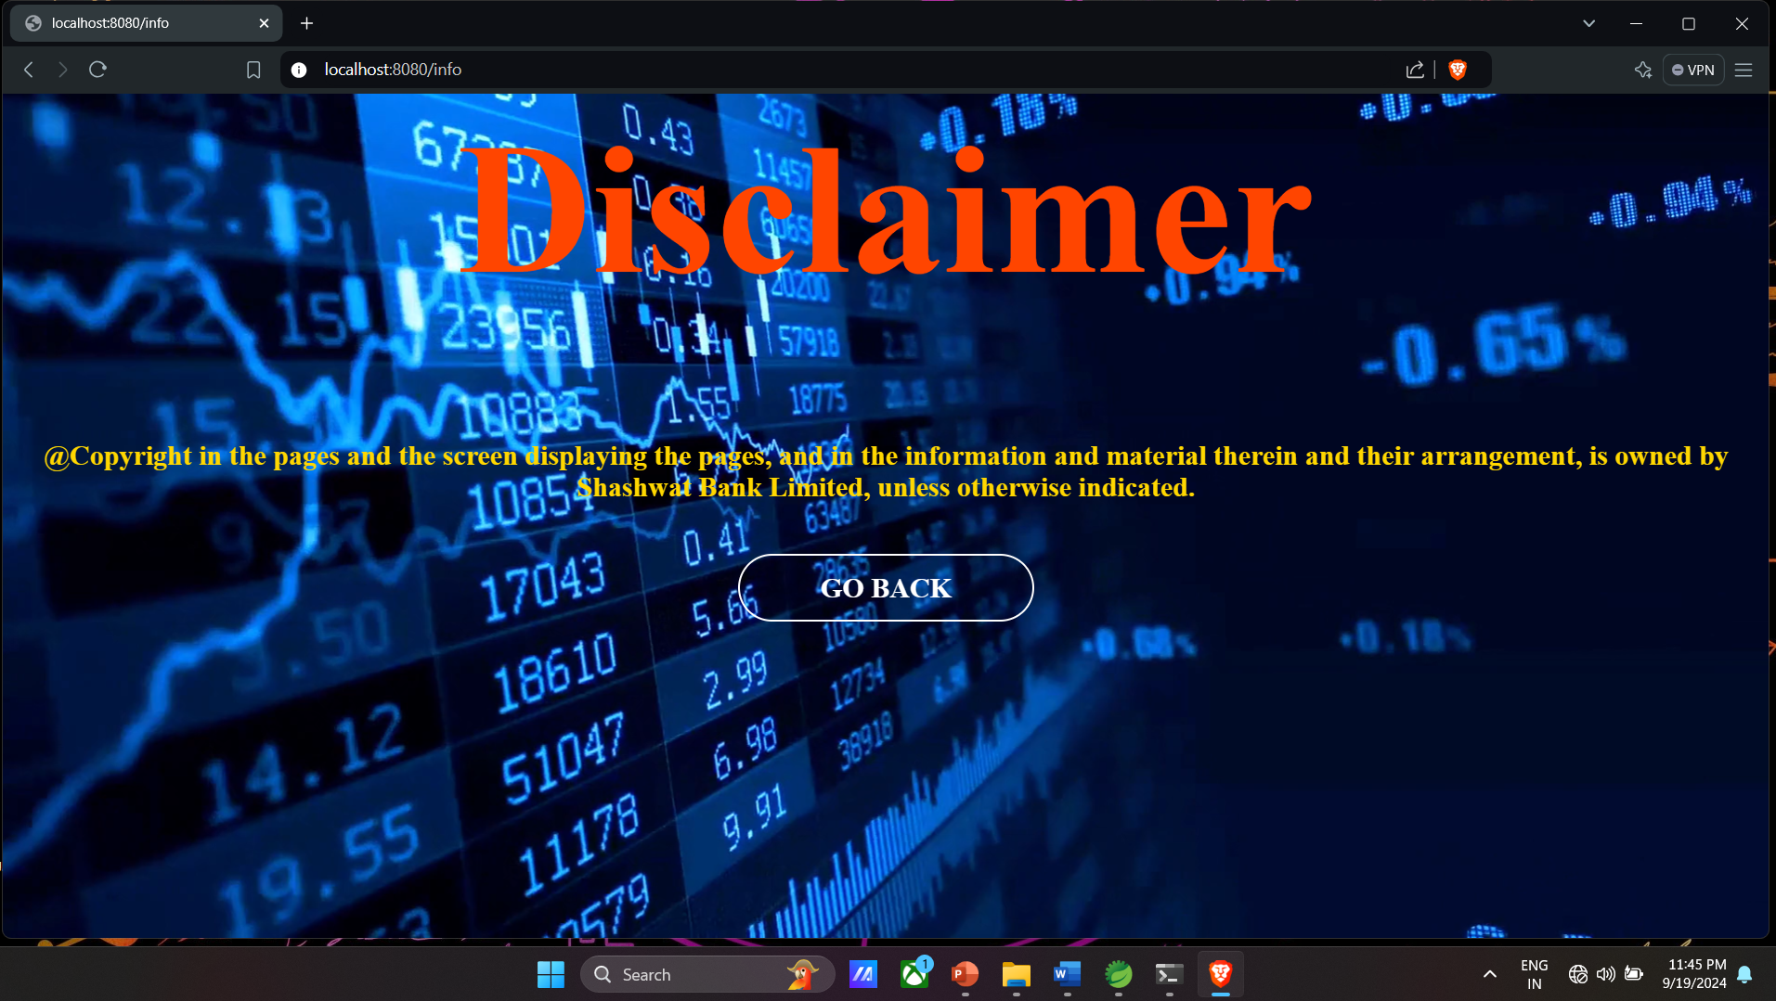

Slide 17
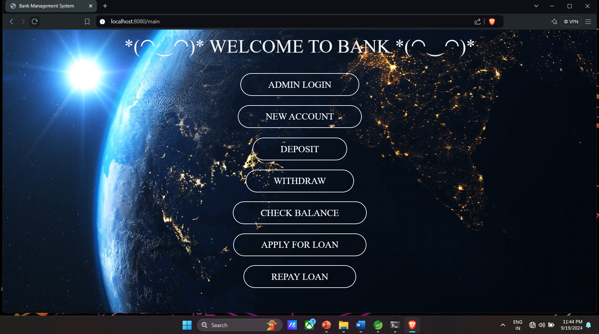

Slide 18
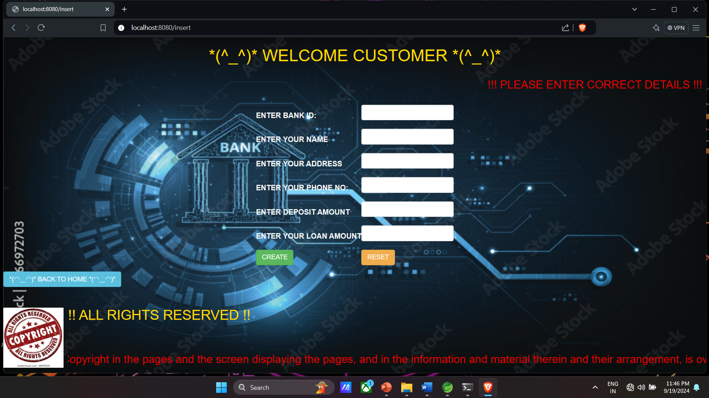

Slide 19
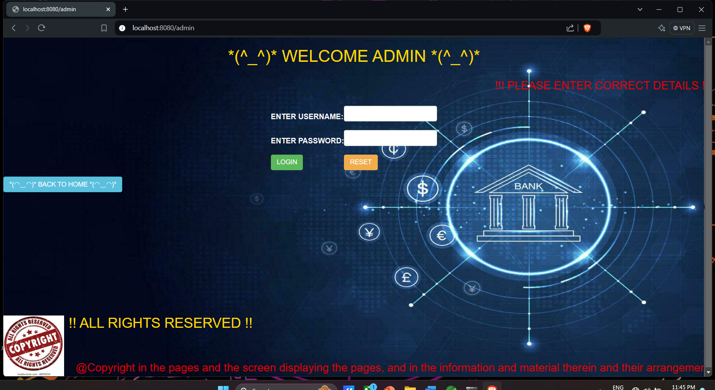

Slide 20
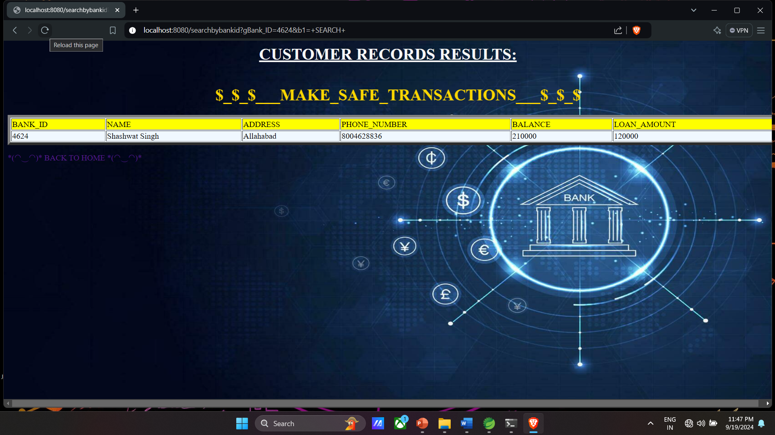

Slide 21
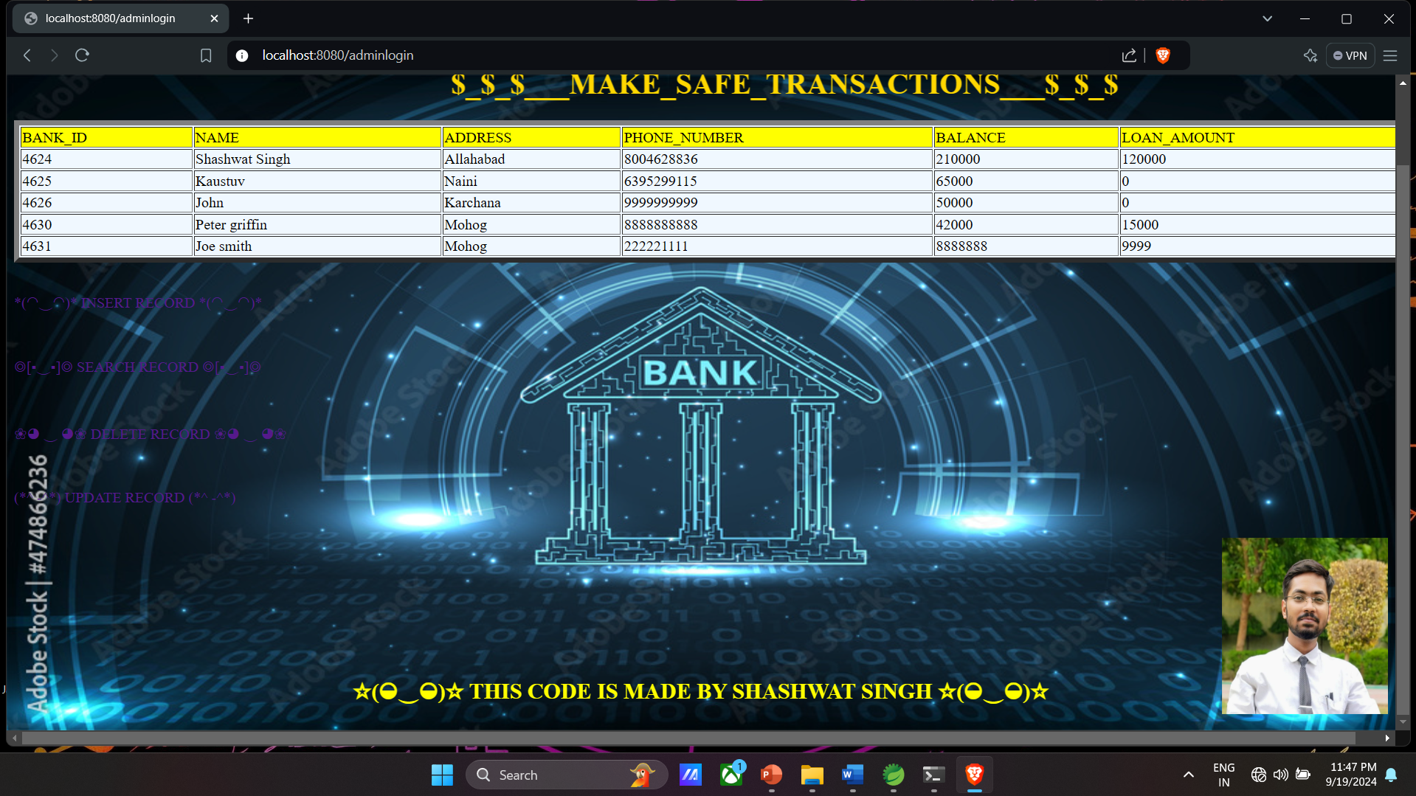

Slide 22

THANK YOU
BY:- SHASHWAT SINGH

